Slide 1

Classifying the Acoustic Environment of YouTube Videos using Deep Neural Networks
Andrew Chang, PhD

Slide 2
Unique Selling Proposition
Goal: classify the environment in which the audio was recorded as either urban or natural.
Combined traditional audio signal processing and pre-trained audio CNN, achieved 90.1% adjusted accuracy (27.6% improvement) for classifying audio recording environment.

Slide 3
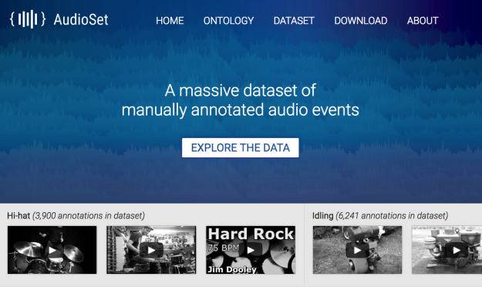
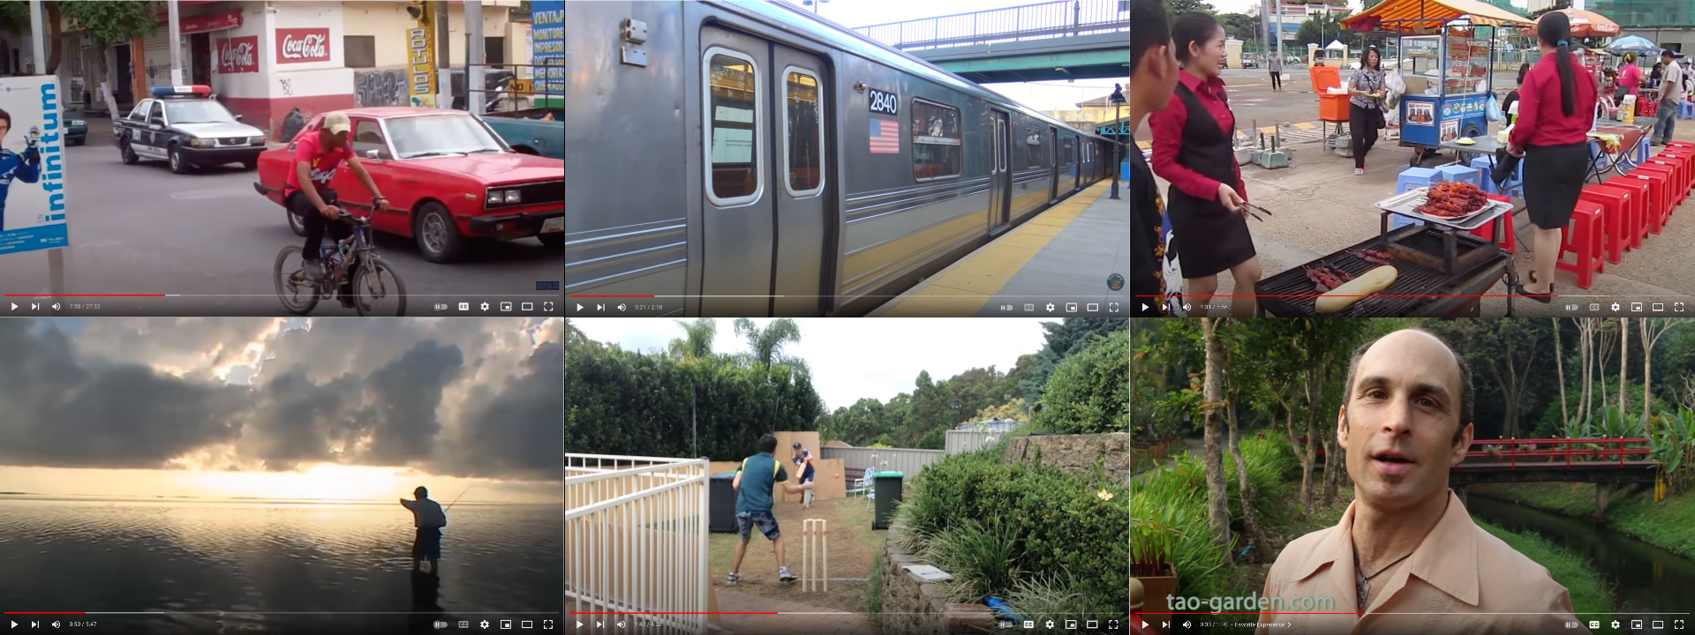
Google AudioSet
Human-annotated 10-second sound clips sourced from YouTube videos
Natural environments : 6,862 recordings
Urban environments: 6,564 recordings
Various recording settings and editing methods used in YouTube audios

Slide 4
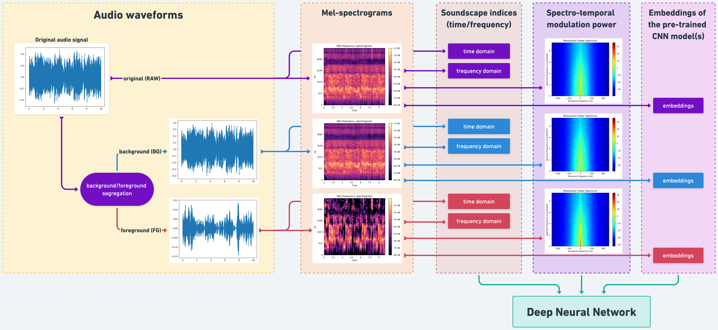
Data preprocessing

Slide 5
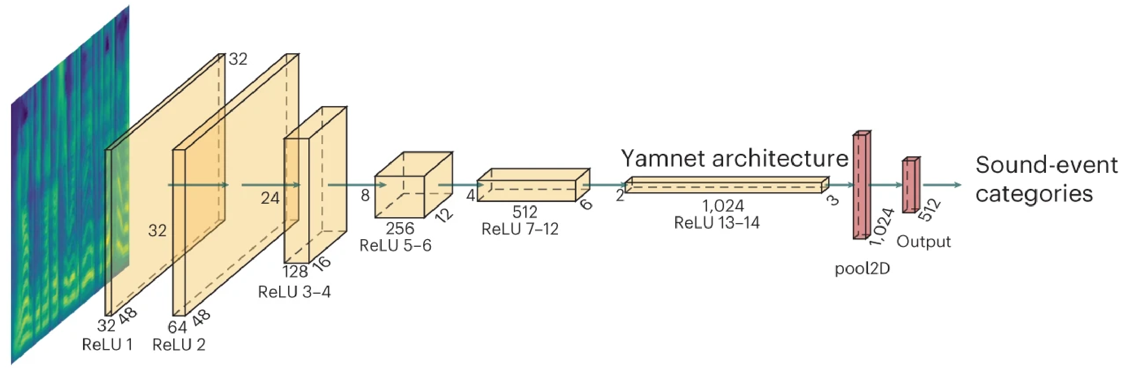
Convert Audio Signals to Pre-trained CNN Embeddings
VGGish (256 embs), YAMNet (1024 embs), PANNs (2048 embs)
Dimensional reduction using PCA

Slide 6
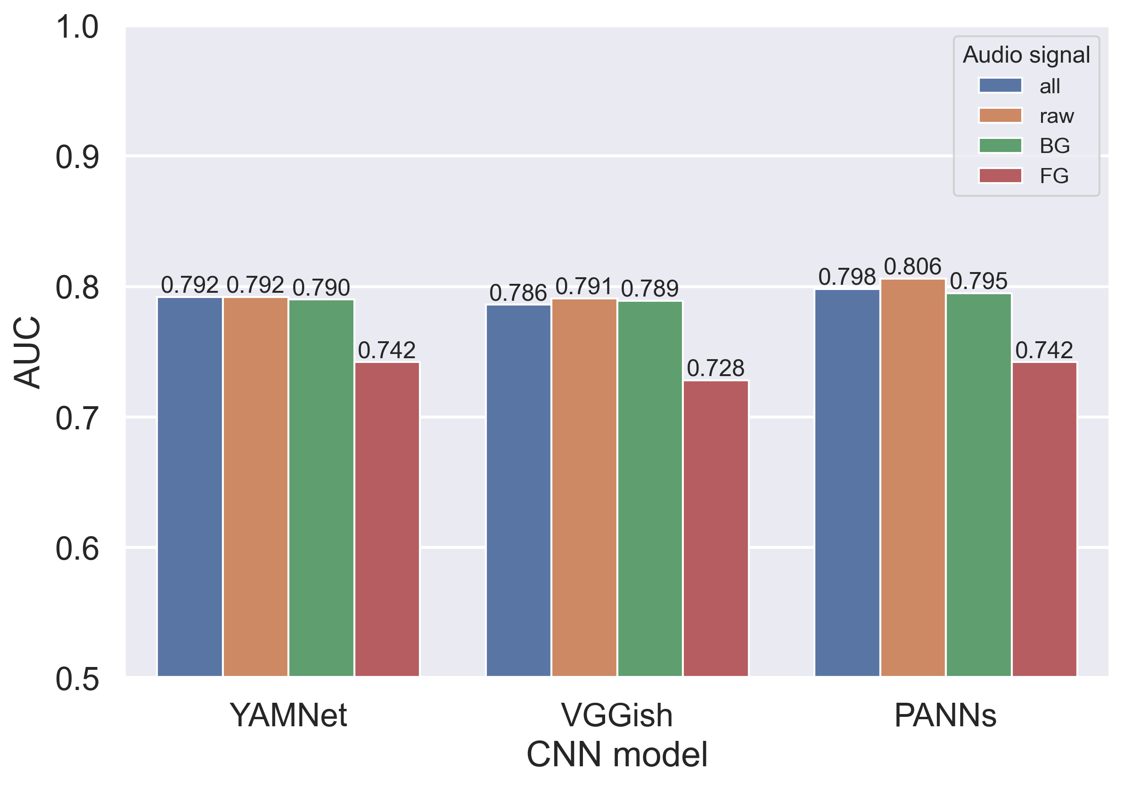
Bayesian hyperparameter tuning & feature selection
Best features: raw audio signals + PANNs embeddings

Slide 7
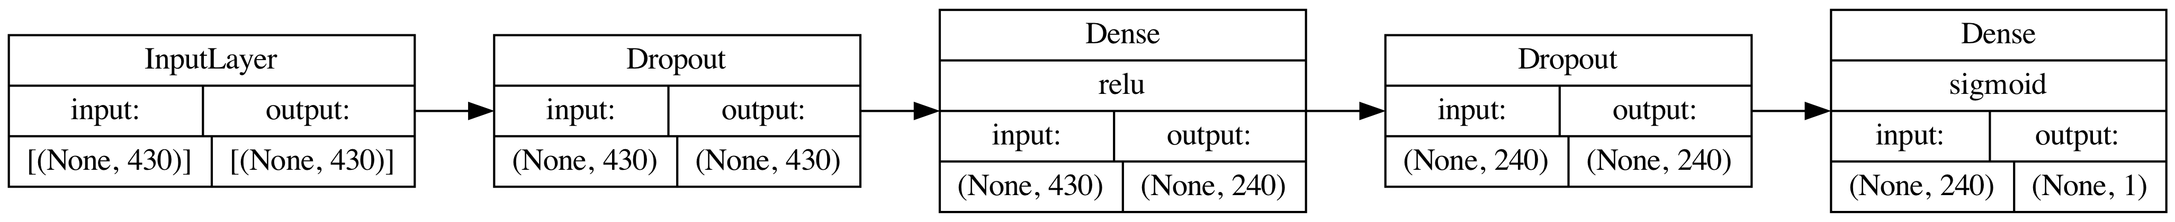
Hyperparameter-tuned multilayer perceptron model

Slide 8
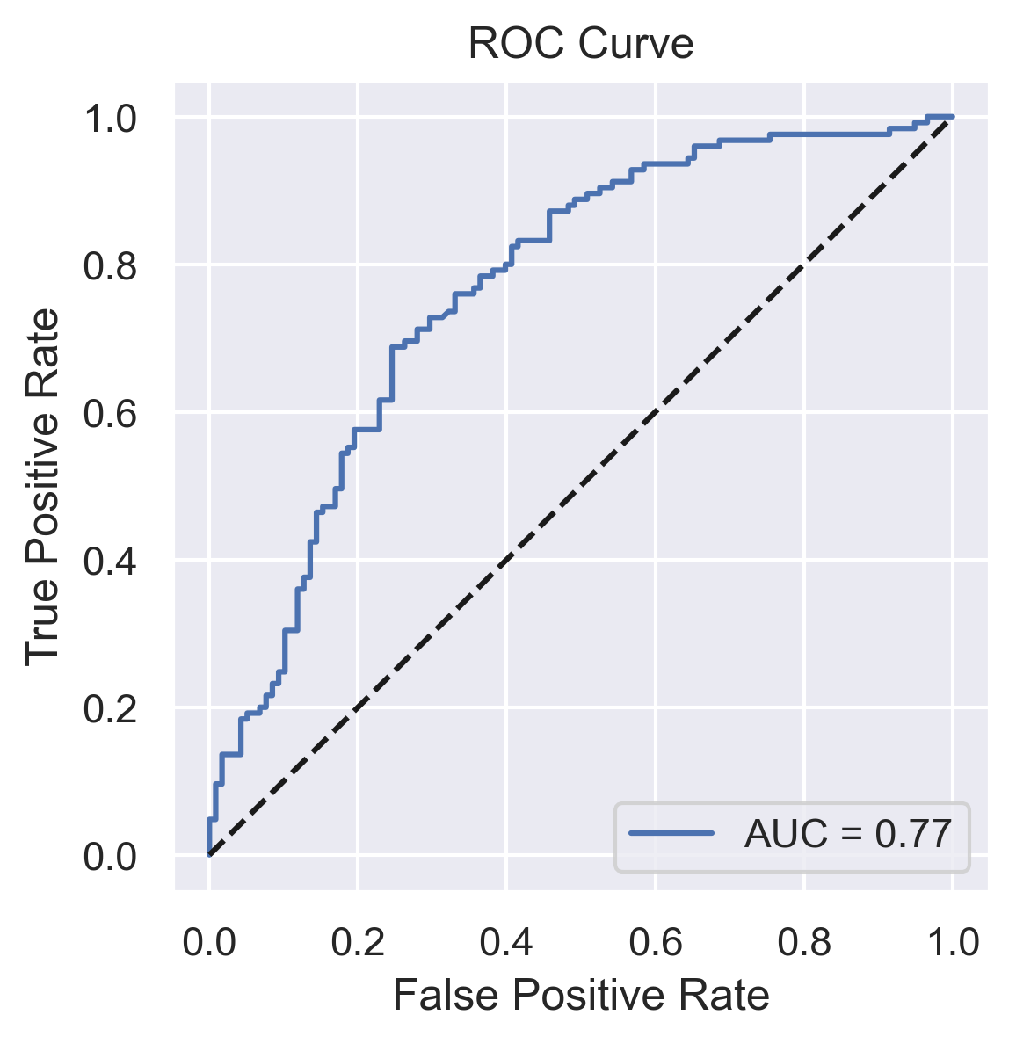
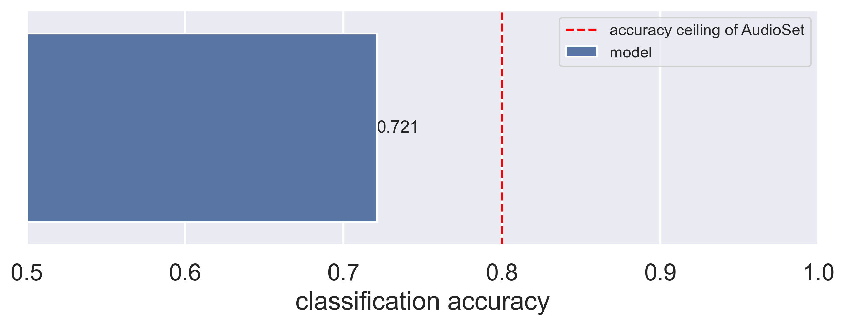
Performances on the testing dataset ROC-AUC: 0.77 adjusted accuracy: 90.1%

Slide 9
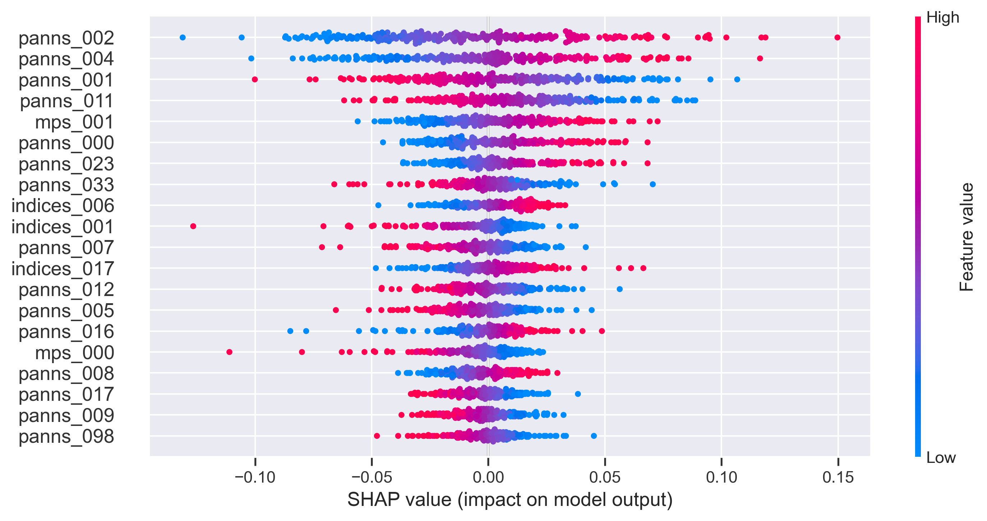
Feature importance
Among the top 20 PCs:
15 PCs of PANNs embeddings
3 PCs of soundscape indices
2 PCs of modulation power spectrum (MPS)

Slide 10
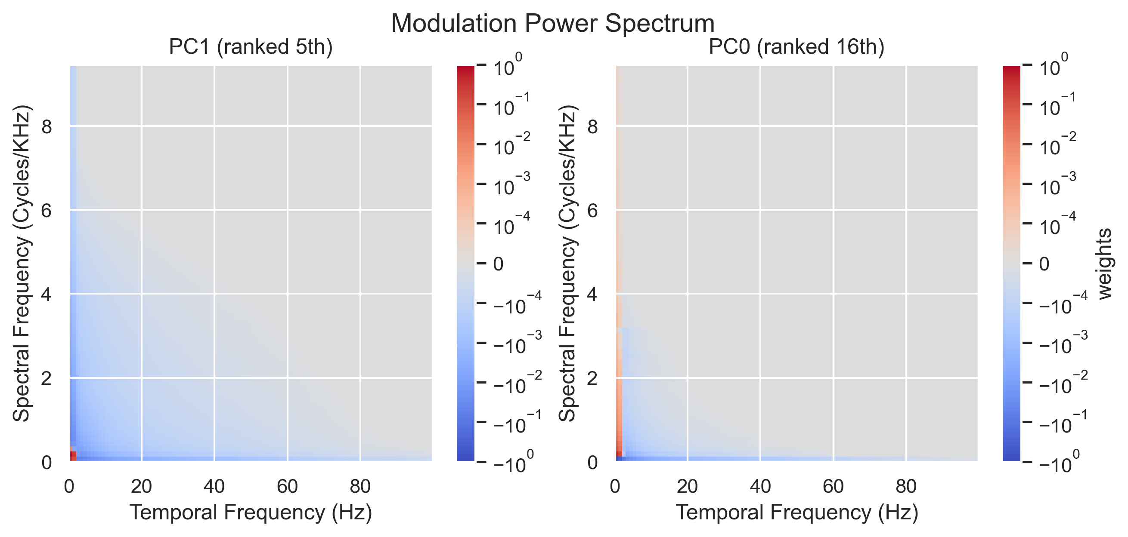
Important MPS features: Low-frequency spectrotemporal modulations

Slide 11
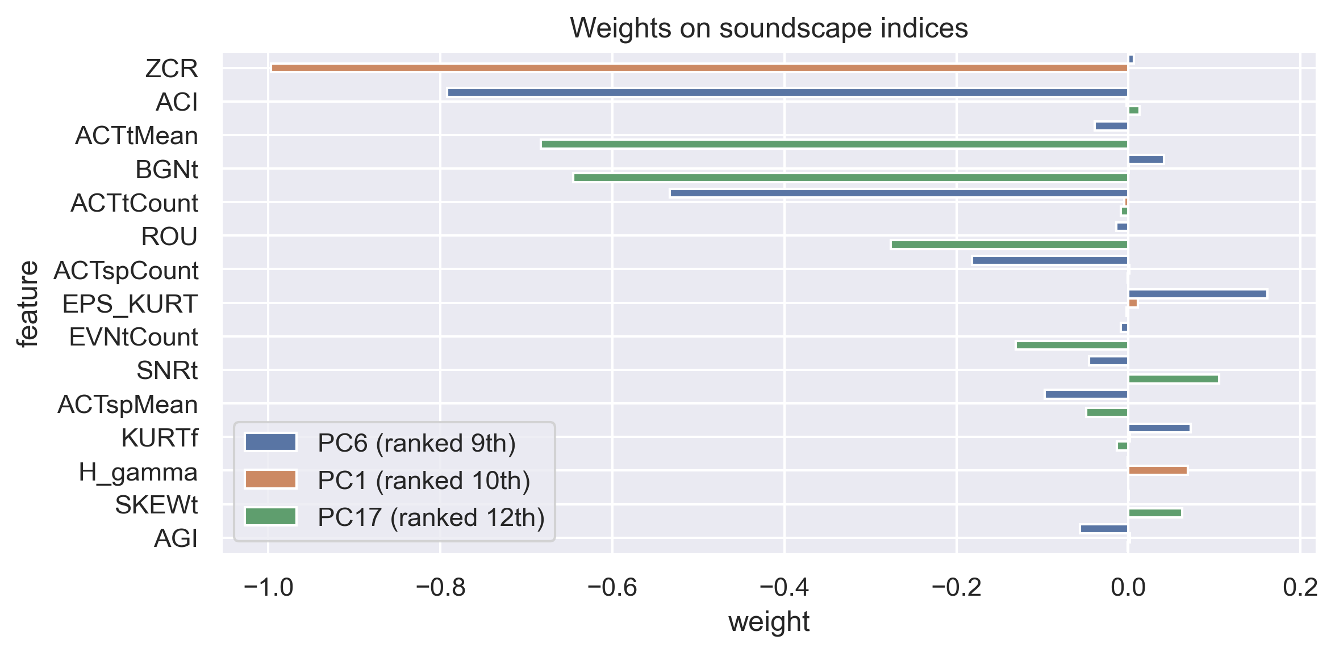
Important soundscape indices
For more in-depth explanations and references of soundscape indices, please visit scikit-maad.

Slide 12
Conclusions
A deep neural network model was created to classify YouTube videos as recorded in urban or natural environments.
The model combined features from audio signal processing and pre-trained audio CNN models, achieving an AUC of 0.766.
Pre-trained audio CNN model embeddings dominated the model's output, but traditional signal processing features were also informative.
The model had low overfitting (0.035) and high adjusted accuracy (0.901).
The zero-crossing rate, acoustic complexity index, and low-frequency spectrotemporal modulations were highly informative features for classifying urban or natural sounds.

Slide 13
Future directions
Improving the dataset with more accurate and diverse environmental labels can further refine the model, making it more practical for classifying different acoustic environments, such as small rooms or cars.
Combining the model’s features with other audio recognition models and feeding them into a generative large language model, such as GPT, can lead to a semantic summary of the audio recording.

